Slide 1

PROJECT #115
TELECOMMUNICATIONS CHURN ANALYSIS
TEAM NO:4
MENTOR : Varun Vennelaganti
TEAM MEMBERS
Alka Dinesh Aswar
Shivani Rohit Chavan
Tushar
Pooja Dimri Hatwal
Balram Somani

Slide 2

PROJECT FLOW
Business Problem
Load Dataset & Observe it
EDA
Visualization
Model Building
Splitting the data into Train and Test set and Feature Scaling
Feature Selection
Model Deployment

Slide 3
Step 1: Business Problem
BUSINESS PROBLEM:
In this project, we’ll discuss how to measure indicators of churn, how to use that data to predict the likelihood of customer churn, and how to prevent at-risk customers from churning before it’s too late.
Customer churn is calculated by the number of customers who leave your company during a given time period. In a more down-to-earth sense, churn rate shows how your business is doing with keeping customers by your side. Every business deals with churn, and more often than not, it's much easier to keep an existing customer than it is to gain a new customer. It is also much easier to save a customer before they leave than it is to convince the customer to come back. Customer loyalty is something all brands strive for - understanding and preventing churn is critical to achieving this. Customer churn, also known as customer attrition, in its most basic form, is when a customer chooses to stop using your products or services. With each customer who churns, there are usually early indicators that could have been uncovered with churn analysis.

Slide 4
data.tail()
Step 2: Load Dataset & Observe it
data.head()
account_length | voice_mail_plan | voice_mail_messages | day_mins | evening_mins | night_mins | international_mins | customer_service_calls | international_plan | day_calls | day_charge | evening_calls | evening_charge | night_calls | night_charge | international_calls | international_charge | total_charge | churn
0 | 128 | 1 | 25 | 265.1 | 197.4 | 244.7 | 10.0 | 1 | 0 | 110 | 45.07 | 99 | 16.78 | 91 | 11.01 | 3 | 2.70 | 75.56 | 0
1 | 107 | 1 | 26 | 161.6 | 195.5 | 254.4 | 13.7 | 1 | 0 | 123 | 27.47 | 103 | 16.62 | 103 | 11.45 | 3 | 3.70 | 59.24 | 0
2 | 137 | 0 | 0 | 243.4 | 121.2 | 162.6 | 12.2 | 0 | 0 | 114 | 41.38 | 110 | 10.30 | 104 | 7.32 | 5 | 3.29 | 62.29 | 0
3 | 84 | 0 | 0 | 299.4 | 61.9 | 196.9 | 6.6 | 2 | 1 | 71 | 50.90 | 88 | 5.26 | 89 | 8.86 | 7 | 1.78 | 66.80 | 0
4 | 75 | 0 | 0 | 166.7 | 148.3 | 186.9 | 10.1 | 3 | 1 | 113 | 28.34 | 122 | 12.61 | 121 | 8.41 | 3 | 2.73 | 52.09 | 0
account_length | voice_mail_plan | voice_mail_messages | day_mins | evening_mins | night_mins | international_mins | customer_service_calls | international_plan | day_calls | day_charge | evening_calls | evening_charge | night_calls | night_charge | international_calls | international_charge | total_charge | churn
3328 | 192 | 1 | 36 | 156.2 | 215.5 | 279.1 | 9.9 | 2 | 0 | 77 | 26.55 | 126 | 18.32 | 83 | 12.56 | 6 | 2.67 | 60.10 | 0
3329 | 68 | 0 | 0 | 231.1 | 153.4 | 191.3 | 9.6 | 3 | 0 | 57 | 39.29 | 55 | 13.04 | 123 | 8.61 | 4 | 2.59 | 63.53 | 0
3330 | 28 | 0 | 0 | 180.8 | 288.8 | 191.9 | 14.1 | 2 | 0 | 109 | 30.74 | 58 | 24.55 | 91 | 8.64 | 6 | 3.81 | 67.74 | 0
3331 | 184 | 0 | 0 | 213.8 | 159.6 | 139.2 | 5.0 | 2 | 1 | 105 | 36.35 | 84 | 13.57 | 137 | 6.26 | 10 | 1.35 | 57.53 | 0
3332 | 74 | 1 | 25 | 234.4 | 265.9 | 241.4 | 13.7 | 0 | 0 | 113 | 39.85 | 82 | 22.60 | 77 | 10.86 | 4 | 3.70 | 77.01 | 0

Slide 5
Step 3: Exploratory Data Analysis (EDA):
Exploratory Data Analysis (EDA) is a data exploration technique to
understand the various aspects of the data
EDA is often used to see what data may disclose outside of formal
modelling and to learn more about the variables in a data collection and
how they interact.
The main purpose of EDA is to help look at data before making any
assumptions

Slide 6
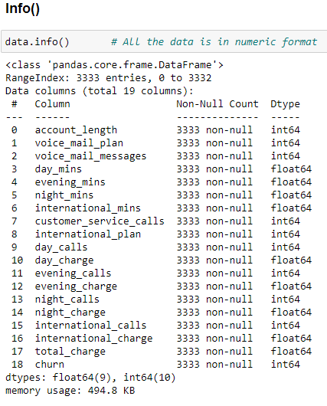
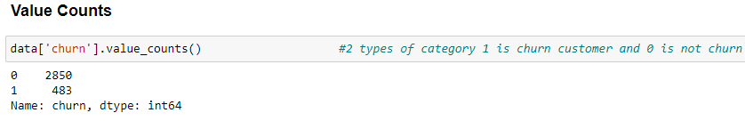
We can se there in no null value present in our dataset and the datatype of each column is numeric only In next image Using value counts function we counted the total no of churn customers i.e 0 means customer’s are not churn and 1 means customers are churn so maximum customers are not left the company we can say
Perform EDA:

Slide 7
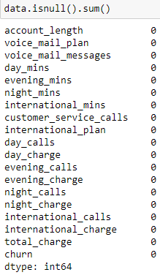
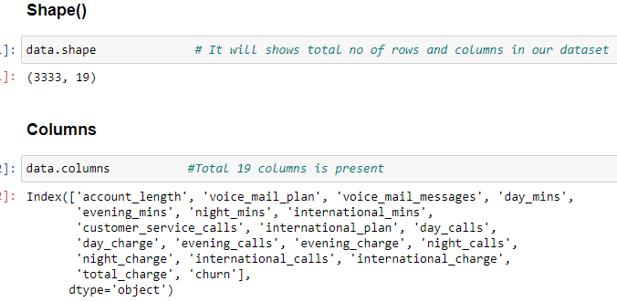
Sum of null values in each column:
Counted Total number of null values present in each column
and its 0
The using shape() we calculated the total number of rows
and columns present in our dataset
Shape of the Data : (3333,19)
Number of Columns in the data : 19
Number of Rows in the data : 3333

Slide 8
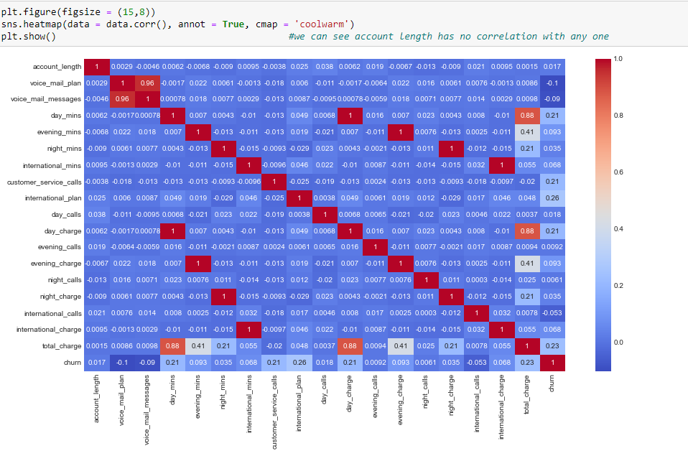
Step 4: Visualizations
Using Bi-variant analysis we can see there some relation between voice mail plan and voice mail message so we will create crossable.
Wherever we got 1’s that columns are highly correlated with each other

Slide 9
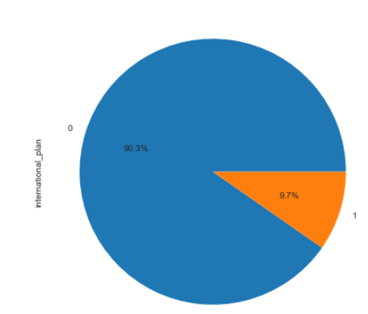
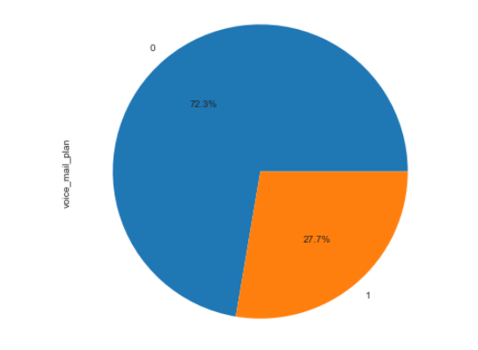
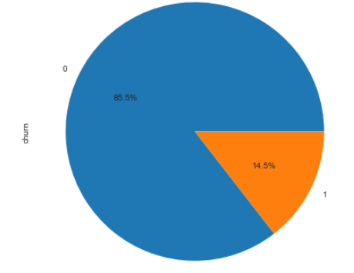
Pie Chart
We used Pie chart on Categorical data,we can easily understand that in our columns how many categories are there and each which value is highest percentage . Like we can see the churn customer is 14.5% and non churn is 85.5%

Slide 10
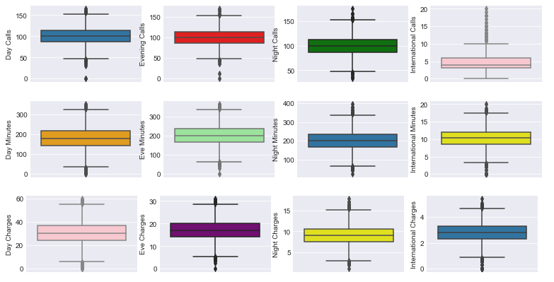
Boxplot
Using this boxplot we can see Day calls are more as compare to Evening and Night call Evening minutes is high as compare to Day and night and Evening charges is high because evening minutes International call is less and have many outliers but minutes and charges very high

Slide 11
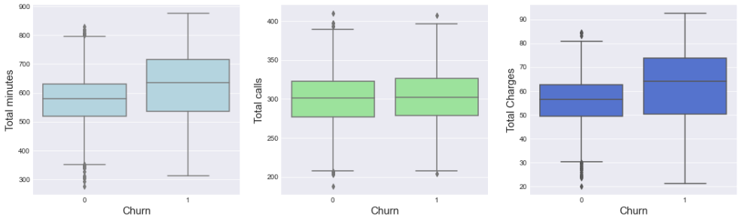
WE can see in Boxplot churn customers spend more time on call than not churn customers In Total call there is no huge difference in both the customers And in total charges churn customers got higher charges than non churn so we can see if minutes is high then we will get higher charges
Boxplot

Slide 12
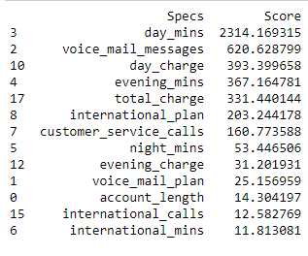
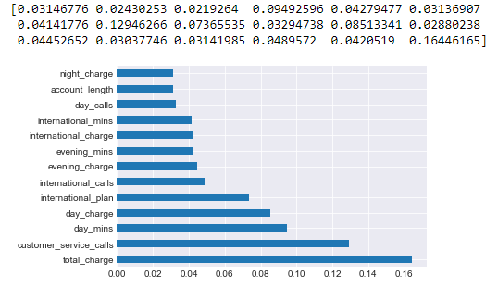
Step 5: Feature Selection Univariate Method Feature Importance
Feature Selection will help us to choose the important columns, we can see in graph so this are the features which is highly correlated with Churn

Slide 13
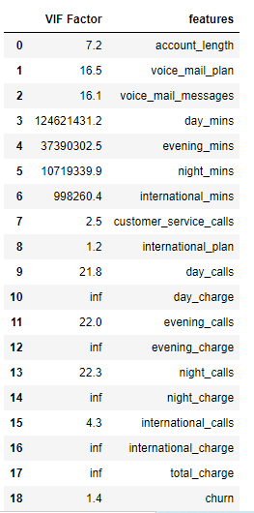
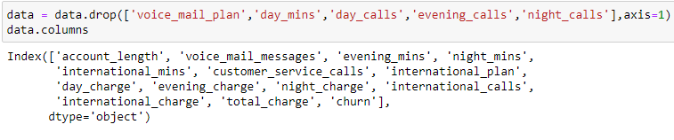
VIF(Variance Inflation Factor)
We can see there are some columns have high range it means there are multicolinearity with each other so we will drop that columns but will see in Univariate and Feature Importance I it is important or not

Slide 14

Step 6: Splitting the data into Train and Test set and Feature Scaling
Here We split the 80% of the data in Train and 20% of the data in Test and we have total 13 columns so we got 2666 in training and 667 in testing
Feature Scaling StandaredScaler Performed
[[ 0.04907096 1.4977234 0.37965204 ... 1.83790804 0.74701384 0.05869364] [ 0.04907096 -0.59750671 -0.14919527 ... 0.62075241 -0.91026301 -0.45952496] [-0.39997885 -0.59750671 -0.04421808 ... 1.02647095 0.42625058 1.4218753 ] ... [ 0.39833192 -0.59750671 0.22515732 ... -0.59640321 0.46634599 -0.51191839] [-0.20040116 -0.59750671 -0.26803736 ... -0.59640321 0.23913868 -0.65290433] [ 0.39833192 0.34173438 -0.93553378 ... -0.59640321 -0.18854567 0.21301609]]

Slide 15
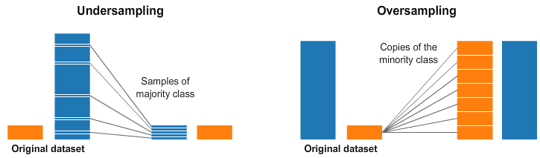
Managed Imbalance Data
We will used this 2 methods for handle the imbalanced data
1.Undersapling : It will reduces the data with low one and make both the dataset size is same
2. Oversampling : It will increases the data with higher one and make both the dataset size same

Slide 16
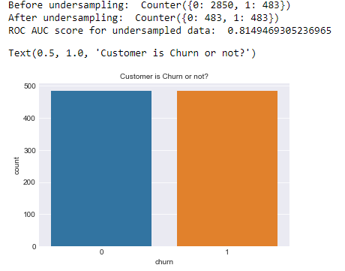
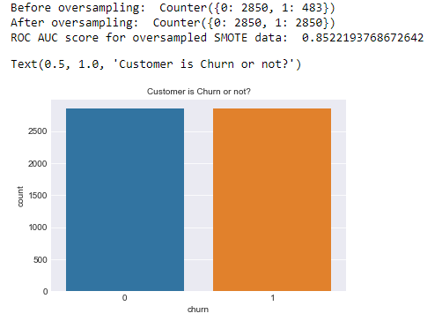
Method 1: Under Sampling
Method 2: Over Sampling
Accuracy Of The Models Using Undersampling ,Oversampling and SMOTE
Model Accuracy | Undersampling | Oversampling | Smote
SVM | 0.5 | 0.5 | 0.66
Random forest | 0.655 | 0.5 | 0.91
Decision Tree | 0.5 | 0.65 | 0.87

Slide 17
Step 7: Model Building
Model Accuracy | On Train Data | On Test Data
SVM | 94.97 | 95.05
Naive Bayes Classifier | 85.82 | 88.60
Random Forest Classifier | 100.0 | 98.20
Decision Tree Classifier | 100.0 | 94.45

Slide 18
1. Support Vector Machine
2. K nearest neighbors
3. Random forest Method
4. Logistic Regression
5. Decision Tree Classifier
Model | Accuracy Before Handling Multicolinearity | Accuracy After Handling Multicolinearity
SVC | 0.925 | 0.90
KNeighborsClassifier | 0.89 | 0.89
RandomForestClassifier | 0.973 | 98
LogisticRegression | 0.851 | 85
DecisionTreeClassifier | 0.949 | 95

Slide 19
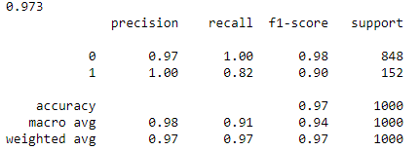
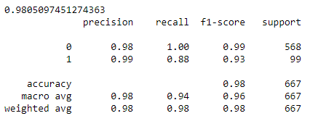
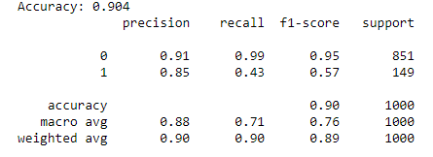
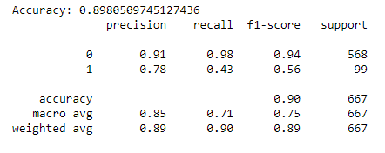
1. Random Forest Method 2. K nearest neighbors Before Handling Multicolinearity After Handling Multicolinearity

Slide 20
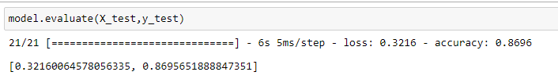
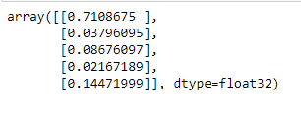
3: Neural Network
As you can see from the results that predictions for the test data are in the form of 2D array with values ranging from 0 to 1. So in order to get in the binary format we will use threshold 0.5, anything more than 0.5 will be 1(churn-yes) else 0(churn-no

Slide 21
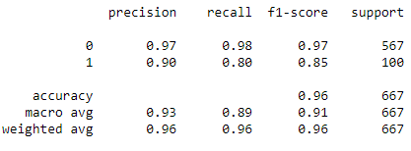
Now lets verify the model prediction on test data
 | y_test | y_pred
2421 | 1 | 1
2069 | 1 | 1
623 | 0 | 0
1067 | 0 | 0
1326 | 0 | 0
2998 | 0 | 0
2052 | 0 | 0
2698 | 0 | 0
895 | 0 | 0
551 | 0 | 0
Here we can see our model predicted accurate result.

Slide 22
Ensemble Technique Bagging technique
Using DecisionTreeClassifier we got
0.9762933592274908
Using RandomorestClassifier we got
0.9783954613295931
We used bagging techniques for reduces the variance and calculate the majority vote for our model because when we build the model there are highly chances that our model is overfit so to solve this problem we used bagging techniques

Slide 23
Boosting Techniques
Boosting technique
Adaboost classification
0.9198908489327652
Boosting is an ensemble modeling technique that attempts to build a strong classifier from the number of weak classifiers. AdaBoost is short for Adaptive Boosting and is a very popular boosting technique that combines multiple “weak classifiers” into a single “strong classifier”.
Stacking Technique
In stacking Techniques It will combine all the models and will gives us to majority vote
0.8814721907536278

Slide 24
We used K Fold Cross Validation Technique here for mean score because we can see we selected random data for predicting the result so every time we are getting the different accuracy so We used this techniques and we take CV =10 It means our train data will be divided into 10 parts and every time we will get different accuracy sousing this method it will calculate mean of that all and gives us final mean score or output
K Fold Cross Validation
Model | Mean Score
SVC | 0.85
Gaussian NB | 0.86
RandomForestClassifier | 0.977
K Nearest Neighbors | 0.867
DecisionTreeClassifier | 0.956

Slide 25
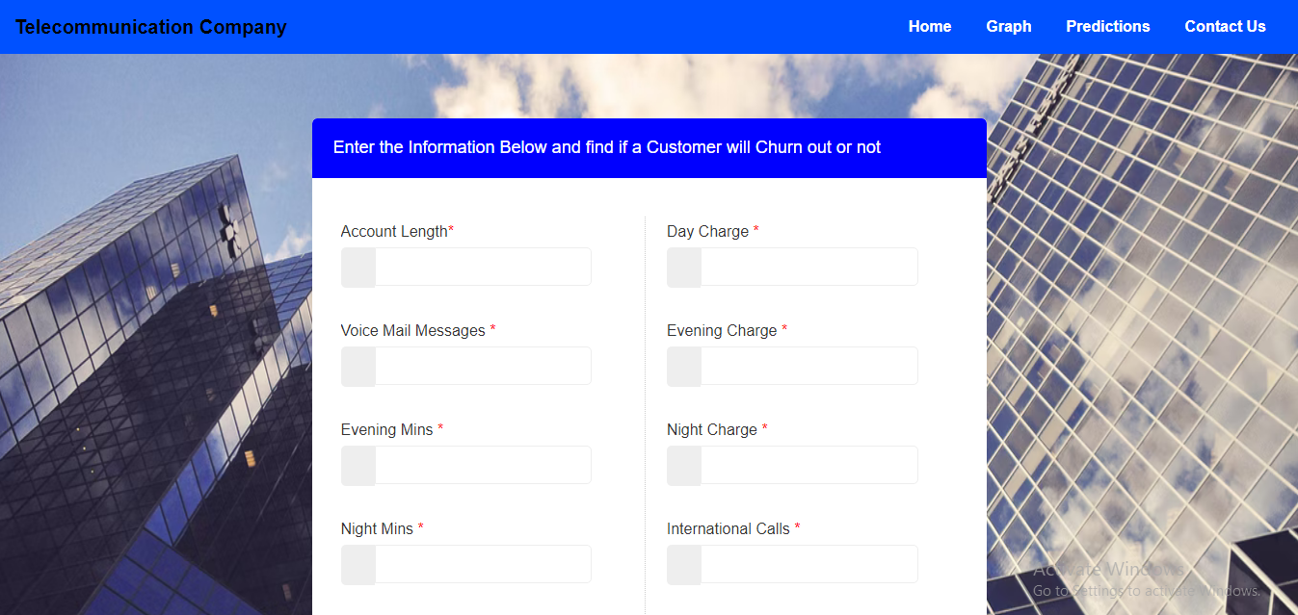
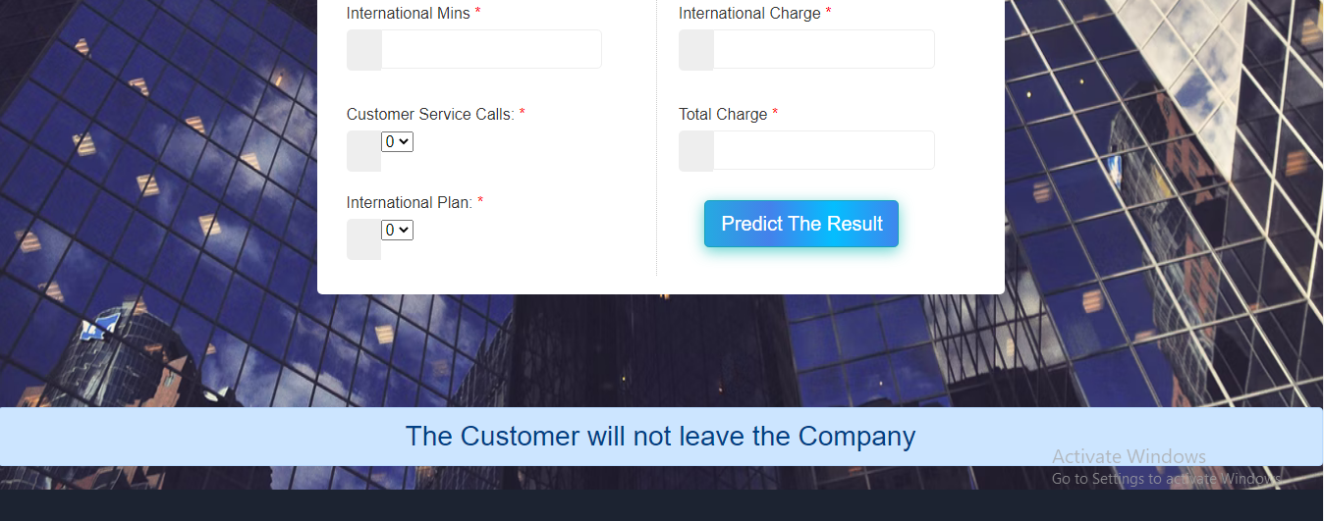
So our Last Step is Model Deployment In this We used Flask for deployment , so using Html file we created this page so after filling the values and submitting we will get the result on same page like the customer is churn or not
Step 8: Model Deployment

Slide 26

Thank You!

